Slide 1
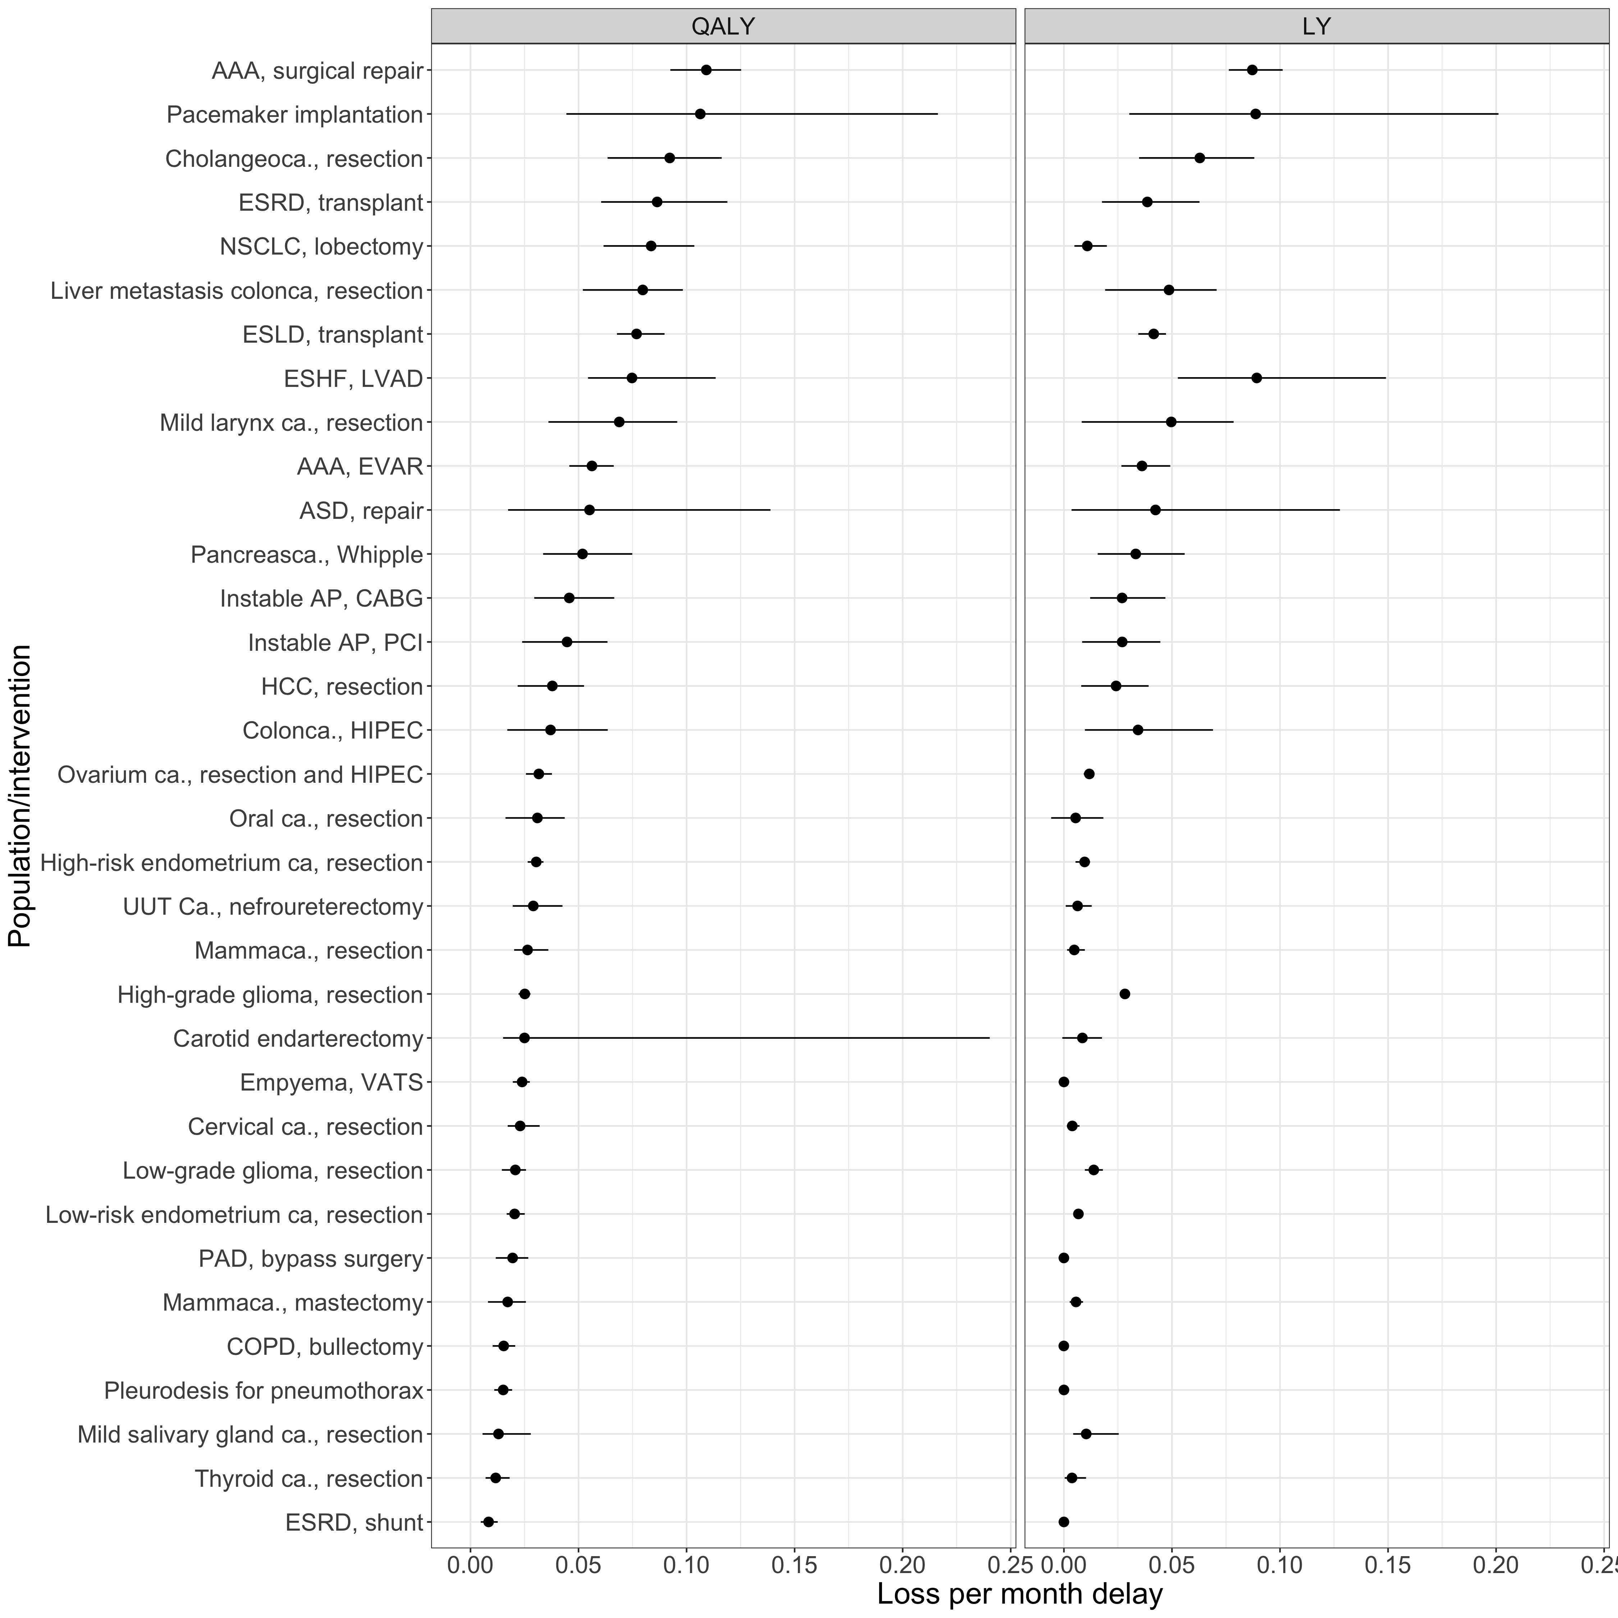
Figure 1: The average loss of QALYs and LYs per month of delay for the investigated surgical interventions. These estimates are based on the results from the simulated scenario of surgery delay of 52 weeks. The dots are the mean estimates. The bars represent the 95% confidence intervals. Abbreviations: QALY: Quality-Adjusted Life-Years, LY: Life-years; AAA: aneurysm of the abdominal aorta; ASD: atrial septum defect; AP: angina pectoris; CABG: coronary artery bypass graft; ESHF: end-stage heart failure; ESLD: end-stage liver disease; ESRD: end-stage renal disease (kidney transplantation); EVAR: endovascular aortic repair; ca.: carcinoma; HCC: hepatocellular carcinoma; HIPEC: hyperthermic intraperitoneal chemotherapy; NSCLC: non-small cell lung carcinoma; UUT: upper urinary track; VATS: video assisted thoracoscopic surgery; PAD: peripheral arterial disease; PCI: percutaneous coronary intervention.

